Slide 1

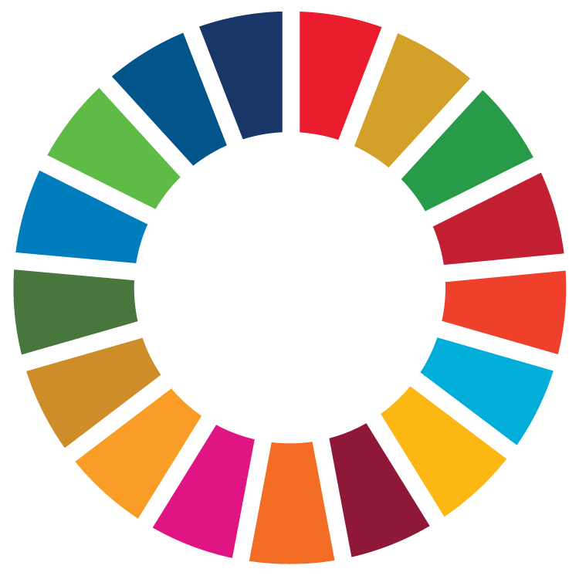
Logo 1
Metabolism of
Cities Living Lab

Slide 2

Logo 2
Metabolism of
Cities Living Lab

Slide 3
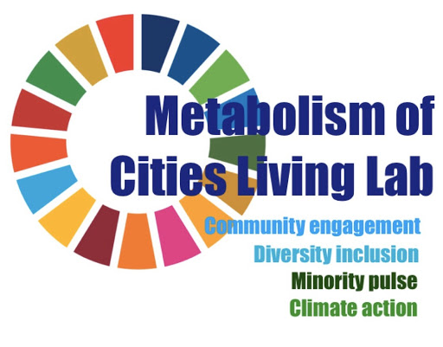
Logo 3

Slide 4
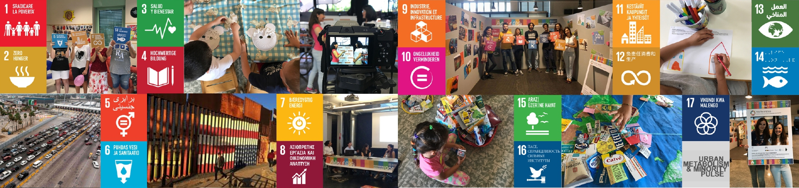
Banner

Slide 5
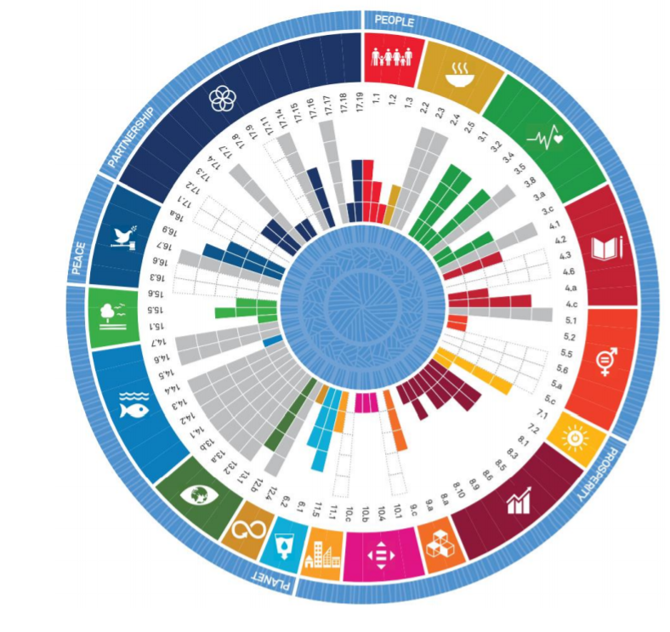
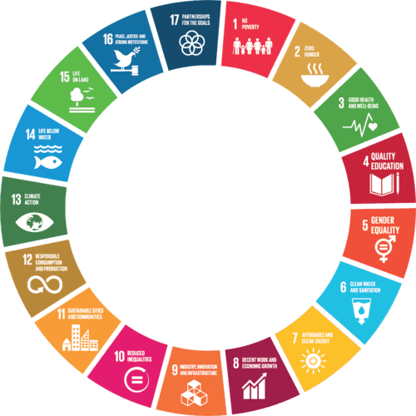
SDG circular method
Ecological ceiling
Social foundation
Regenerative and distributive economy

Slide 6
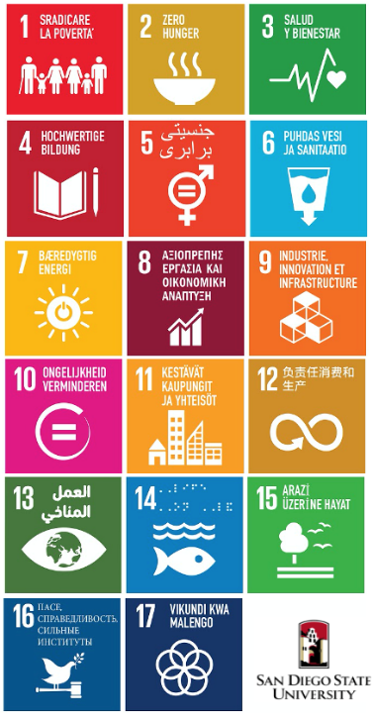
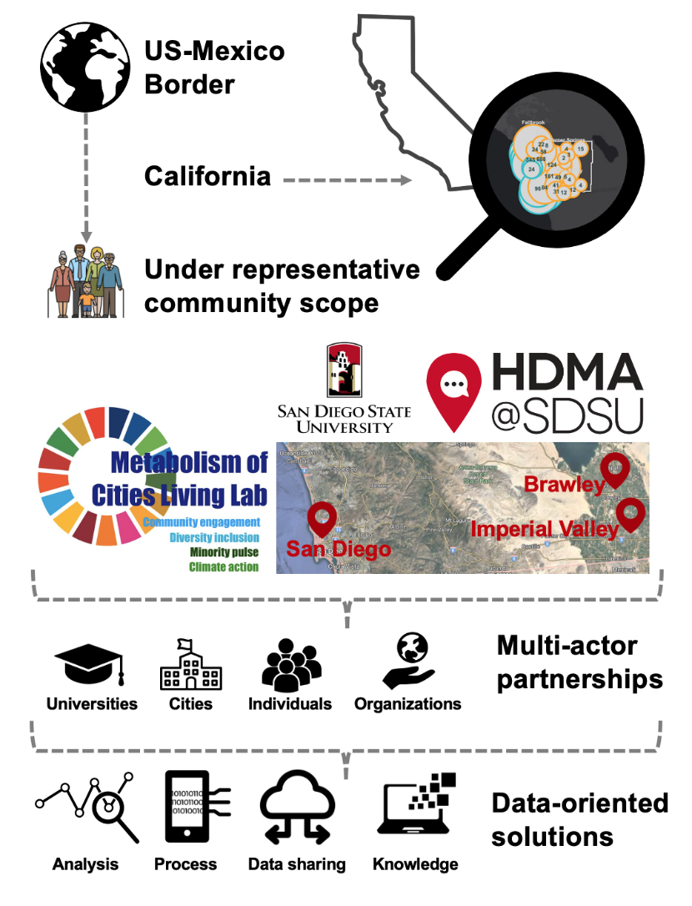
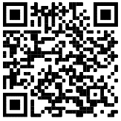
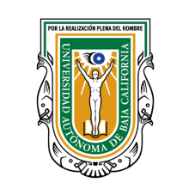

Metabolism of
Cities Living Lab
Ecological ceiling
Social foundation
Regenerative & distributive economy
*
*
*
*
*
Strengthening Diversity & Deliberation in Climate Adaptation Planning by viewing the city as a living organism through citizen science, data science, mathematical modeling, and nature-based solutions.
SDSU as a Leader. “Empowering minorities in San Diego & Imperial County communities Post-COVID-19 along the US-Mexico border while localizing the United Nations Sustainable Development Goals by 2030.”
* Phase 1 selected SDGs.
Find out more
About us
Our team
Donate
Visual material
Metabolism of
Cities Living Lab
Universidad Autónoma de Baja California

